Slide 1
Project
DATA 205
Hye Young Park
Date: 05/13/2020
Title: Crime Density by City in Montgomery County, MD

Slide 2
Dataset Information
Data1: Median House Price
Data Source:
from Zillow
https://www.zillow.com/research/data/
Data from April 1996 to Feburary 2020
Data2: Police Dispatched Incidents
Data Source:
from dataMontgomery ttps://data.montgomerycountymd.gov/browse?q=Police%20Dispatched%20Incidents&sortBy=relevance
Data from March 16th, 2020 / Updated Everyday on the website
Data3: Population – Census Bureau 2010
Data Source:
from CensusViewer
http://censusviewer.com/cities/MD/

Slide 3
Dataset Information
Data1: Median House Price
Median House Price between 2017 and 2019
Data2: Police Dispatched Incidents
Crimes between 2017 and 2019
Data3: Population – Census Bureau 2010
25 Cities in Montgomery County, MD
continued
(1) Ashton-Sandy Spring
(2) Barnesville
(3) Beallsville
(4) Bethesda
(5) Boyds
(6) Brinklow
(7) Cabin John
(8) Chevy Chase
(9) Clarksburg
(10) Damascus
(11) Derwood
(12) Dickerson
(13) Gaithersburg
(14) Garrett Park
(15) Germantown
(16) Glen Echo
(17) Kensington
(18) Montgomery Village
(19) Olney
(20) Poolesville
(21) Potomac
(22) Rockville
(23) Silver Spring
(24) Spencerville
(25) Washington Grove

Slide 4
Hypothesis
The median house price is negatively correlated to the crime rate in that city.
Majority of crimes happen in the evening / nighttime.

Slide 5
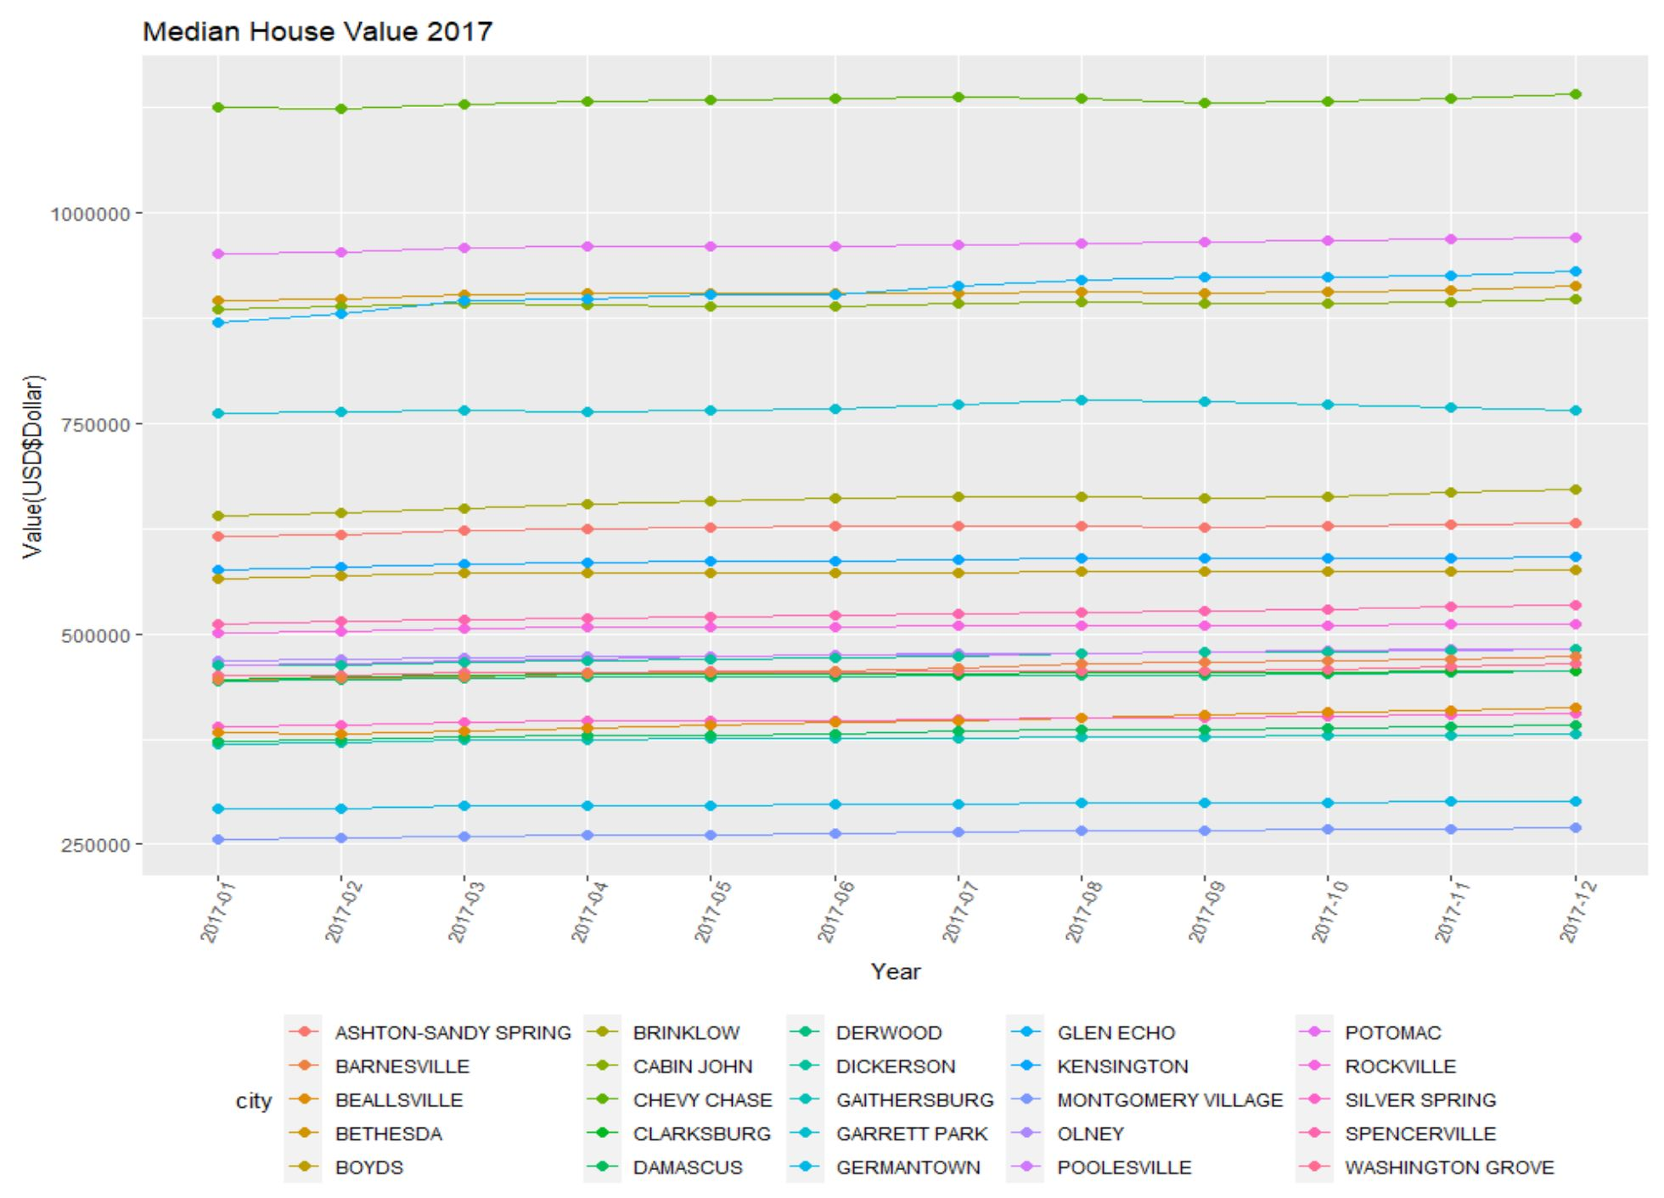
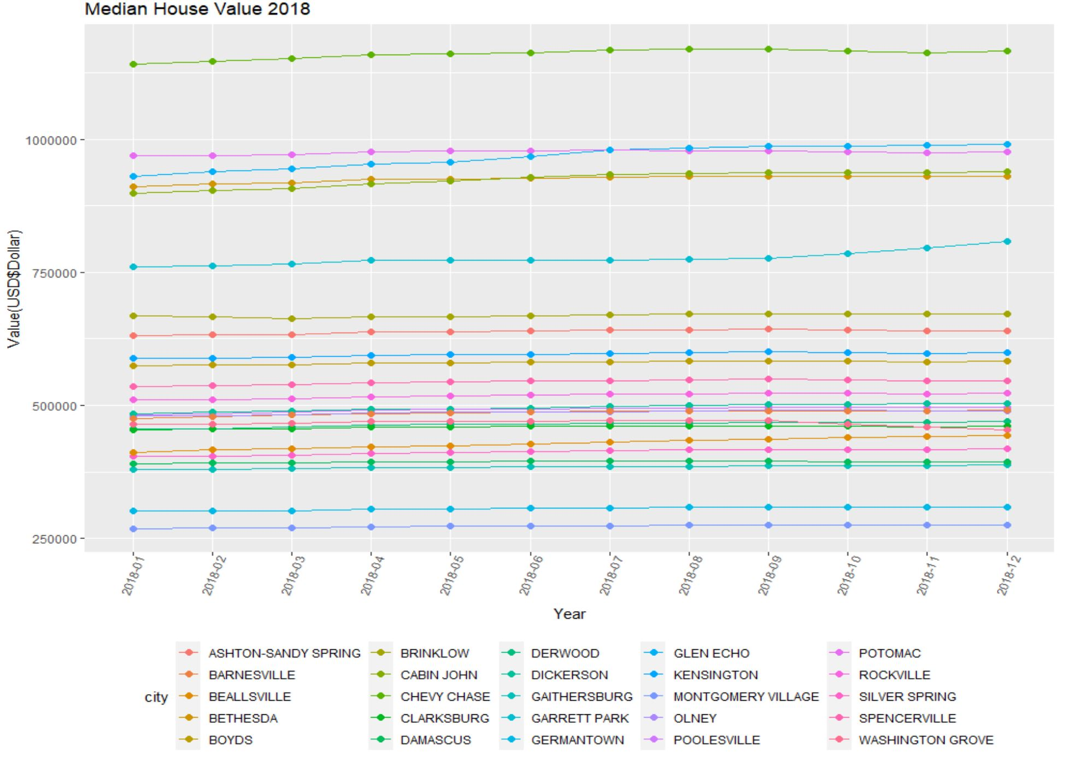
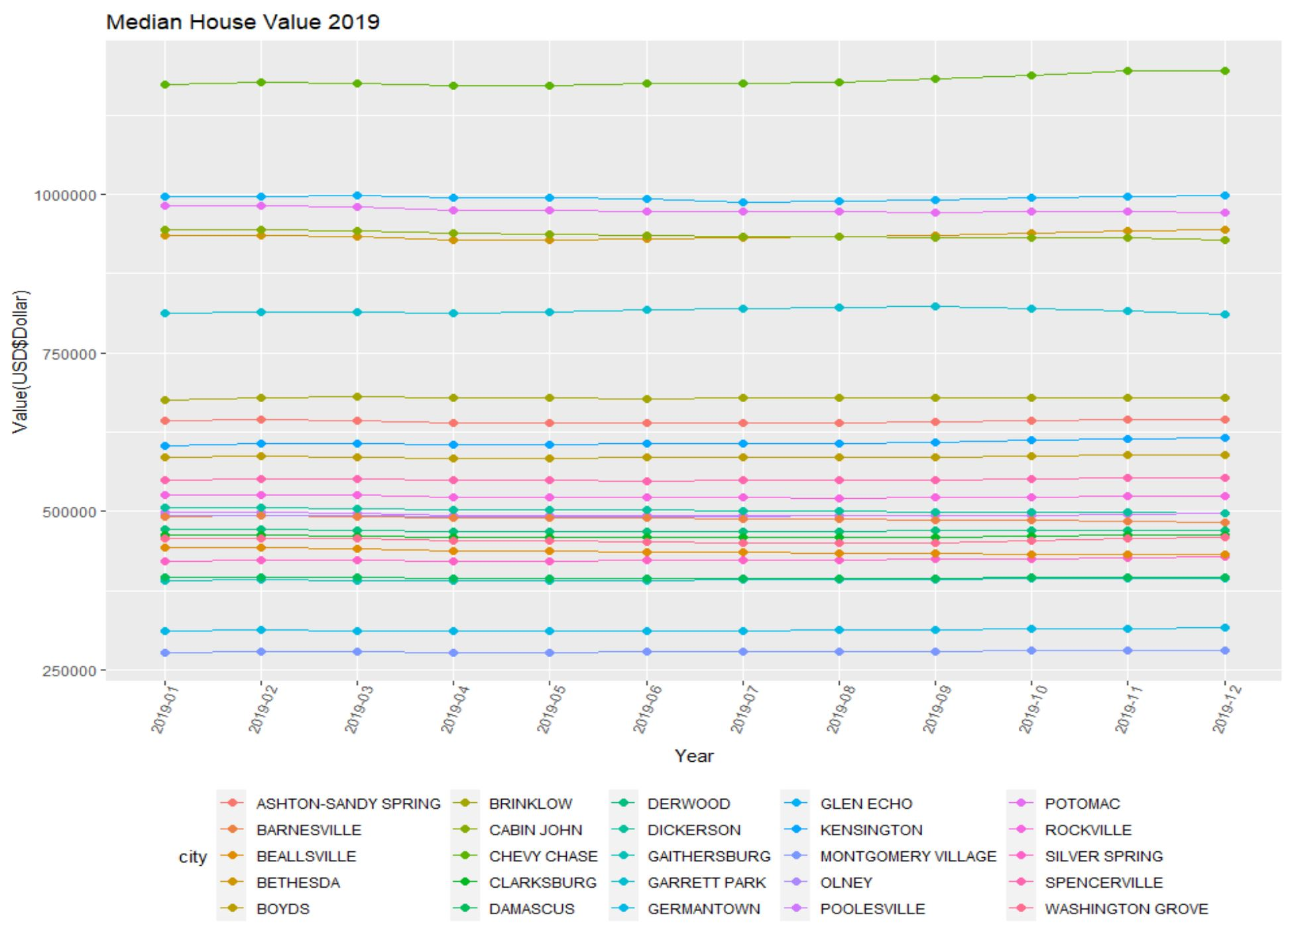
Data1: Median House Price

Slide 6
Data1: Median House Price
continued
Chevy Chase: $1,142,165
Potomac: $971,291
Glen Echo: $930,210
Bethesda: $912,808
Cabin John: $898449
Beallsville: $411,979
Silver Spring: $404,867
Damascus: $391,956
Gaithersburg: $380,717
Germantown: $301,461
Montgomery Village: $269,196

Slide 7
Data1: Median House Price
continued
Chevy Chase: $1,165,319
Glen Echo: $989,914
Potomac: $975,783
Cabin John: $939,721
Bethesda: $929,906
Beallsville: $442,491
Silver Spring: $418,167
Damascus: $393,176
Gaithersburg: $387,711
Germantown: $309,579
Montgomery Village: $275,892

Slide 8
Data1: Median House Price
continued
Chevy Chase: $1,195,812
Glen Echo: $998,481
Potomac: $970,608
Bethesda: $944,547
Cabin John: $928,472
Beallsville: $433,208
Silver Spring: $427,807
Damascus: $397,055
Gaithersburg: $394,826
Germantown: $026,055
Montgomery Village: $281,317

Slide 9
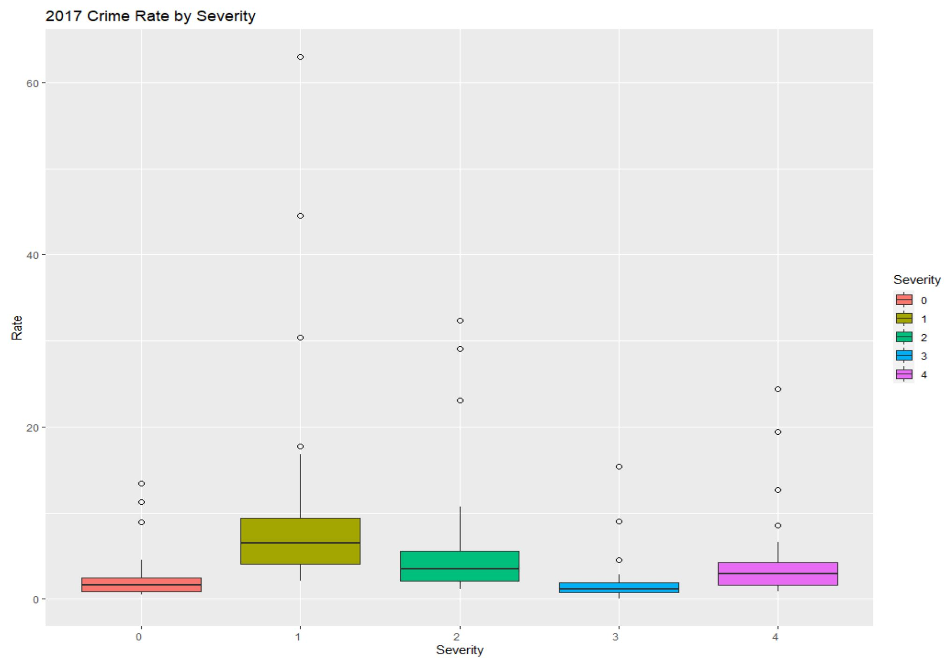
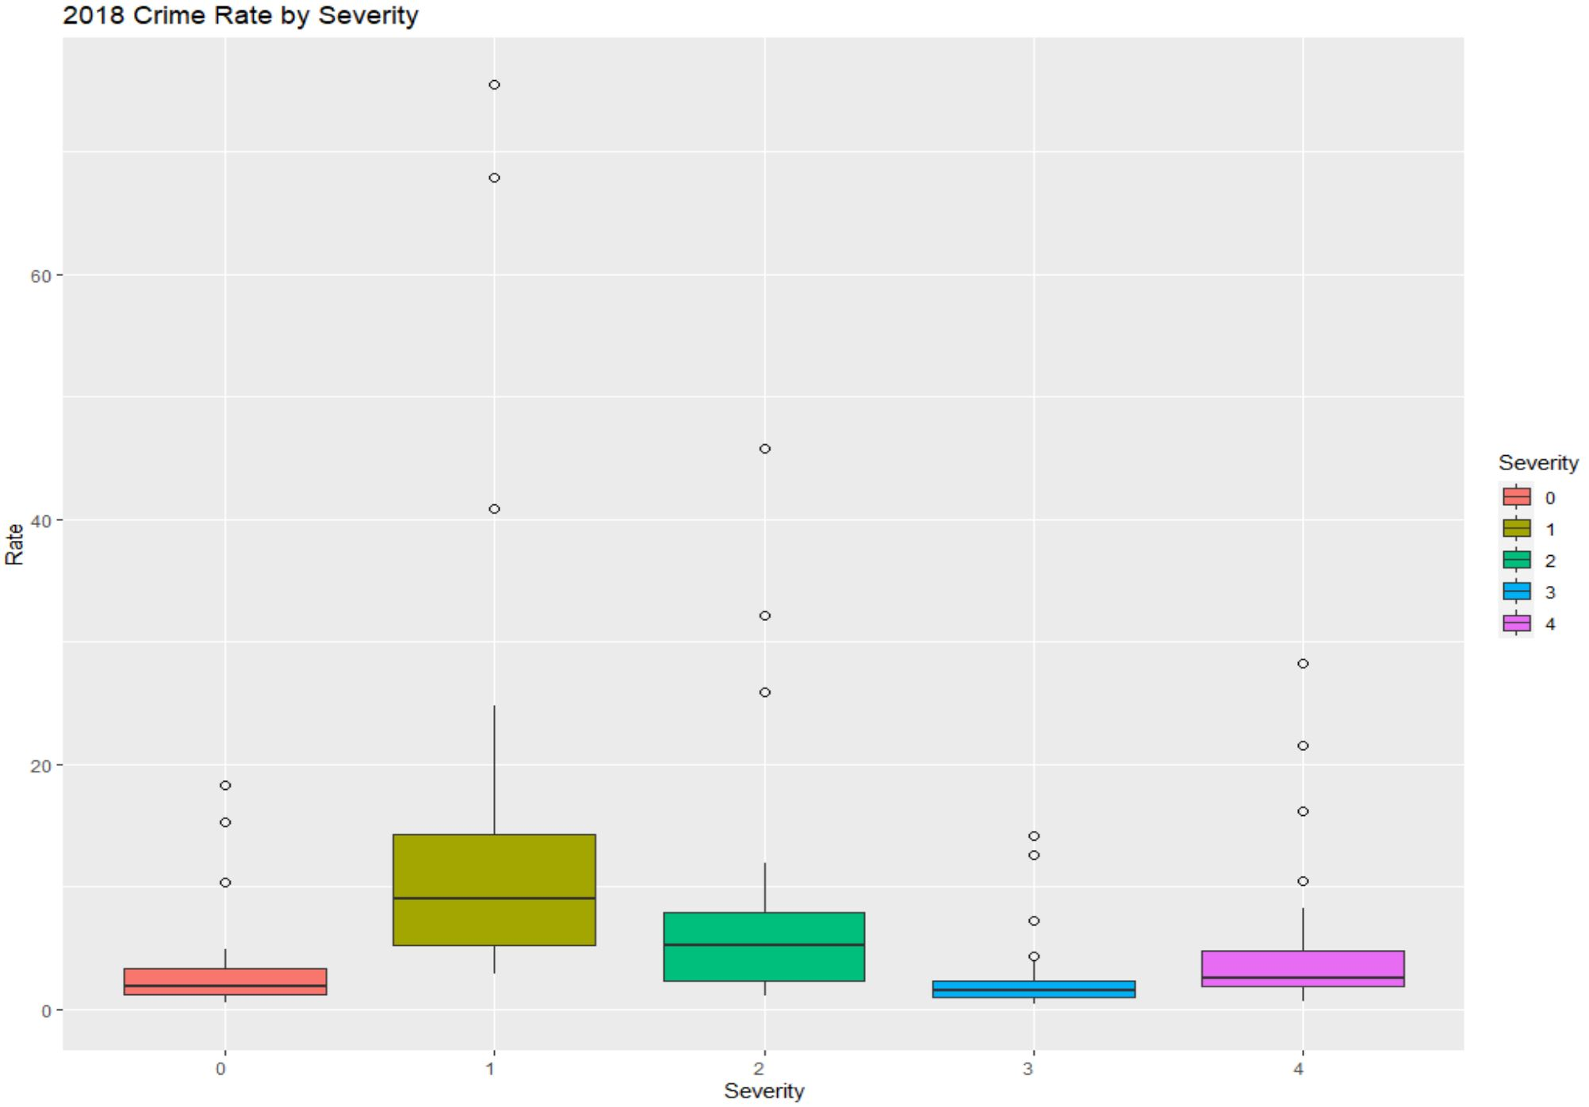
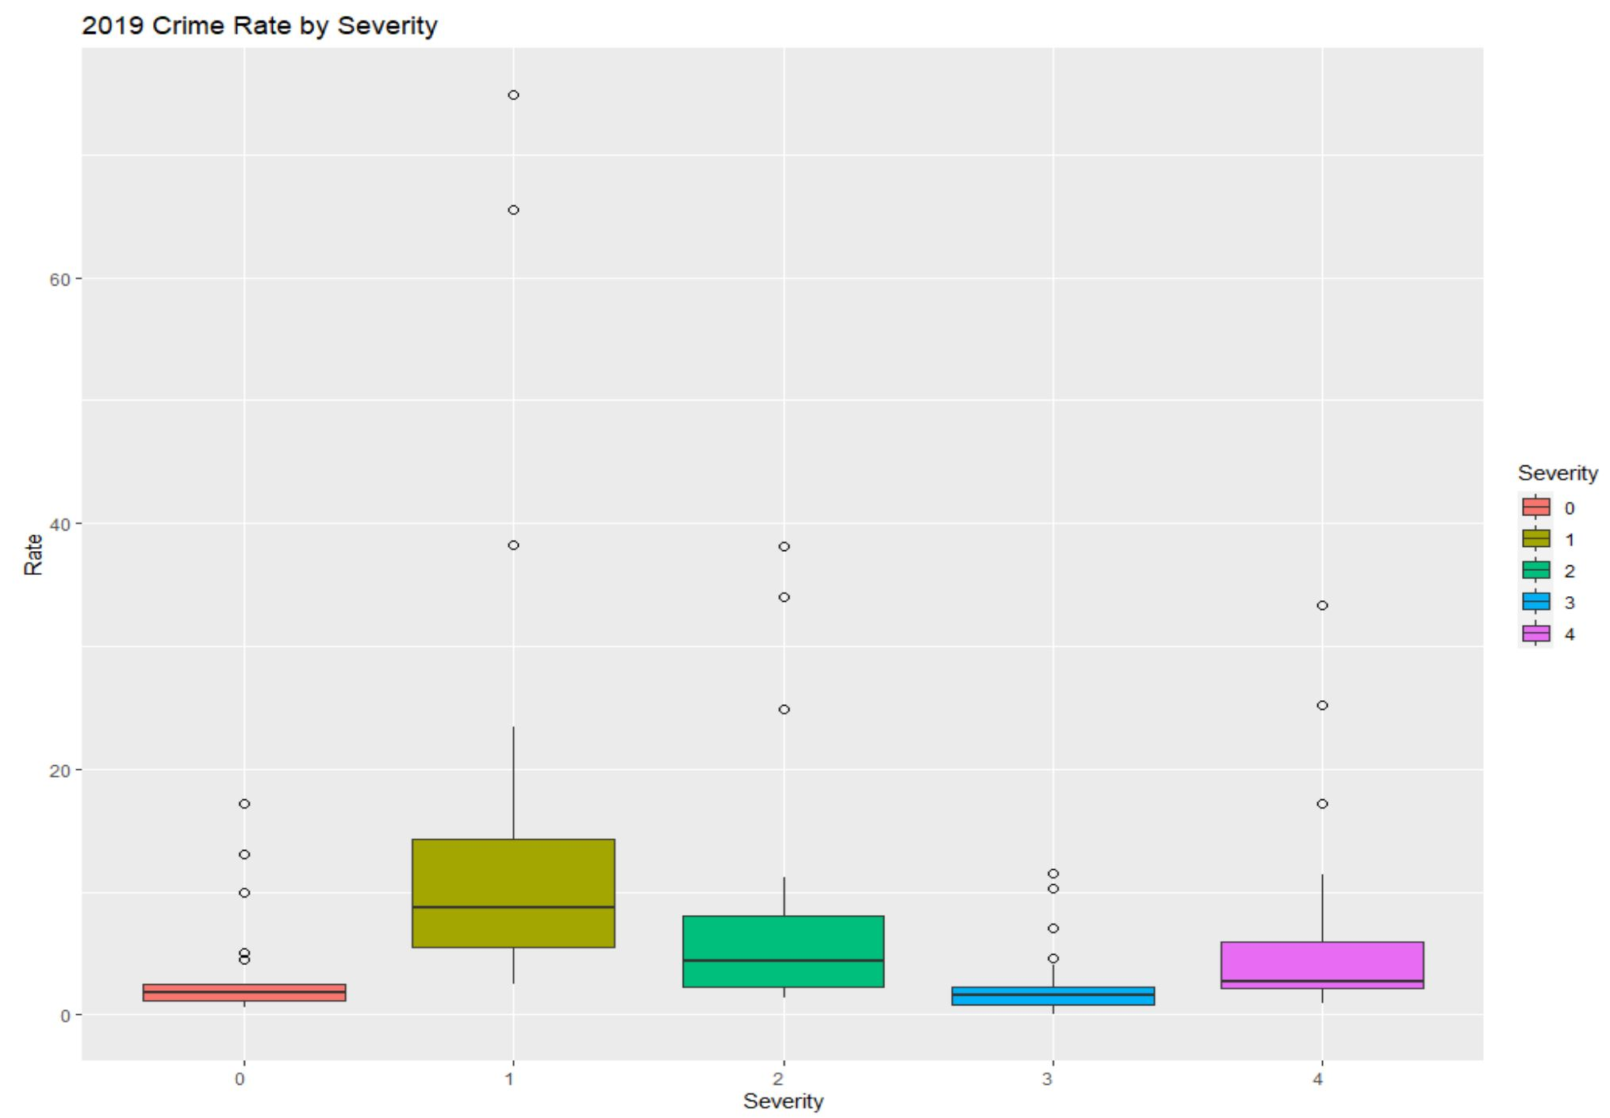
Data2: Police Dispatched Incidents
Types of Severity
0
– Most severe
1
2
3
4
Abduction(Kidnapping)
Active Assailant/Shooter
Animal Vicious
Car Jacking
Check Welfare
Domestic Violence
Harassment, Stalking, Threats
Parking Offense
Robbery
Sexual Assault
Shooting
Stabbing
Traffic Violation
Weapons/Firearms
Burglary
Mental Disorder
Missing, Runaway, Found Person
Overdose – VIA FRS
Pedestrian Struck
Non-Priority Response Transport
Theft/Larceny/Holding Suspect
Driving under the influence … …

Slide 10
Data2: Police Dispatched Incidents
Total Crime Frequency (Yearly)
0
1
2
3
4
Total
2017
17,620
69,158
44,132
10,443
28,196
169,549
2018
20,251
92,240
49,201
15,773
35,514
212,979
2019
19,420
86,983
46,750
15,572
36,778
205,503
Total
57,291
248,381
140,083
41,788
100,488

Slide 11
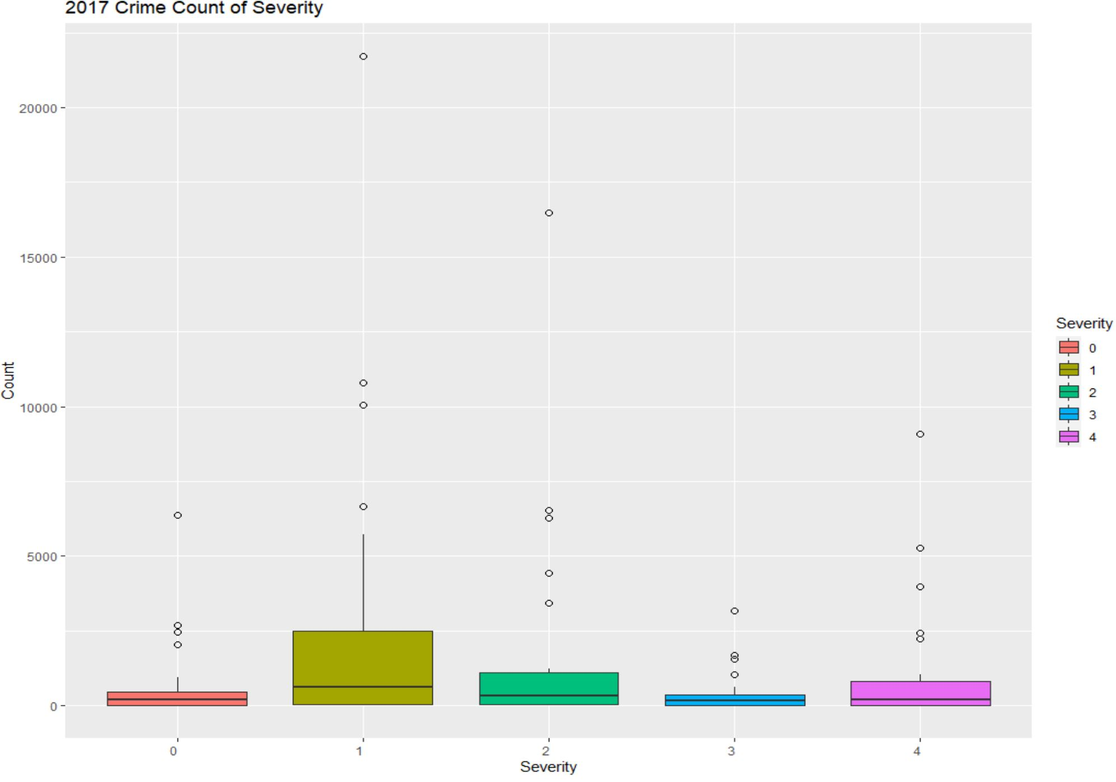
Data2: Police Dispatched Incidents
continued
Total amount of Crime by Severity – Boxplot (2017)
Max: 21718
Max: 16481
10811
10046
Max: 9097
6545
Max: 3183
Max: 6365
6265
1687
Q3: 2626.50
Q3: 115.50
1551
5263
Median: 631
Q3: 373.75
3975
2682
Median: 329
2451
Q1: 47.50
Q1: 27
Median: 171
Min: 12
Q1: 7.75
Q3: 886.5
Q3: 537.50
Min: 6
Median: 195
Min: 0
Median: 205
Q1: 18
Q1: 8.75
Min: 5
Min: 1

Slide 12
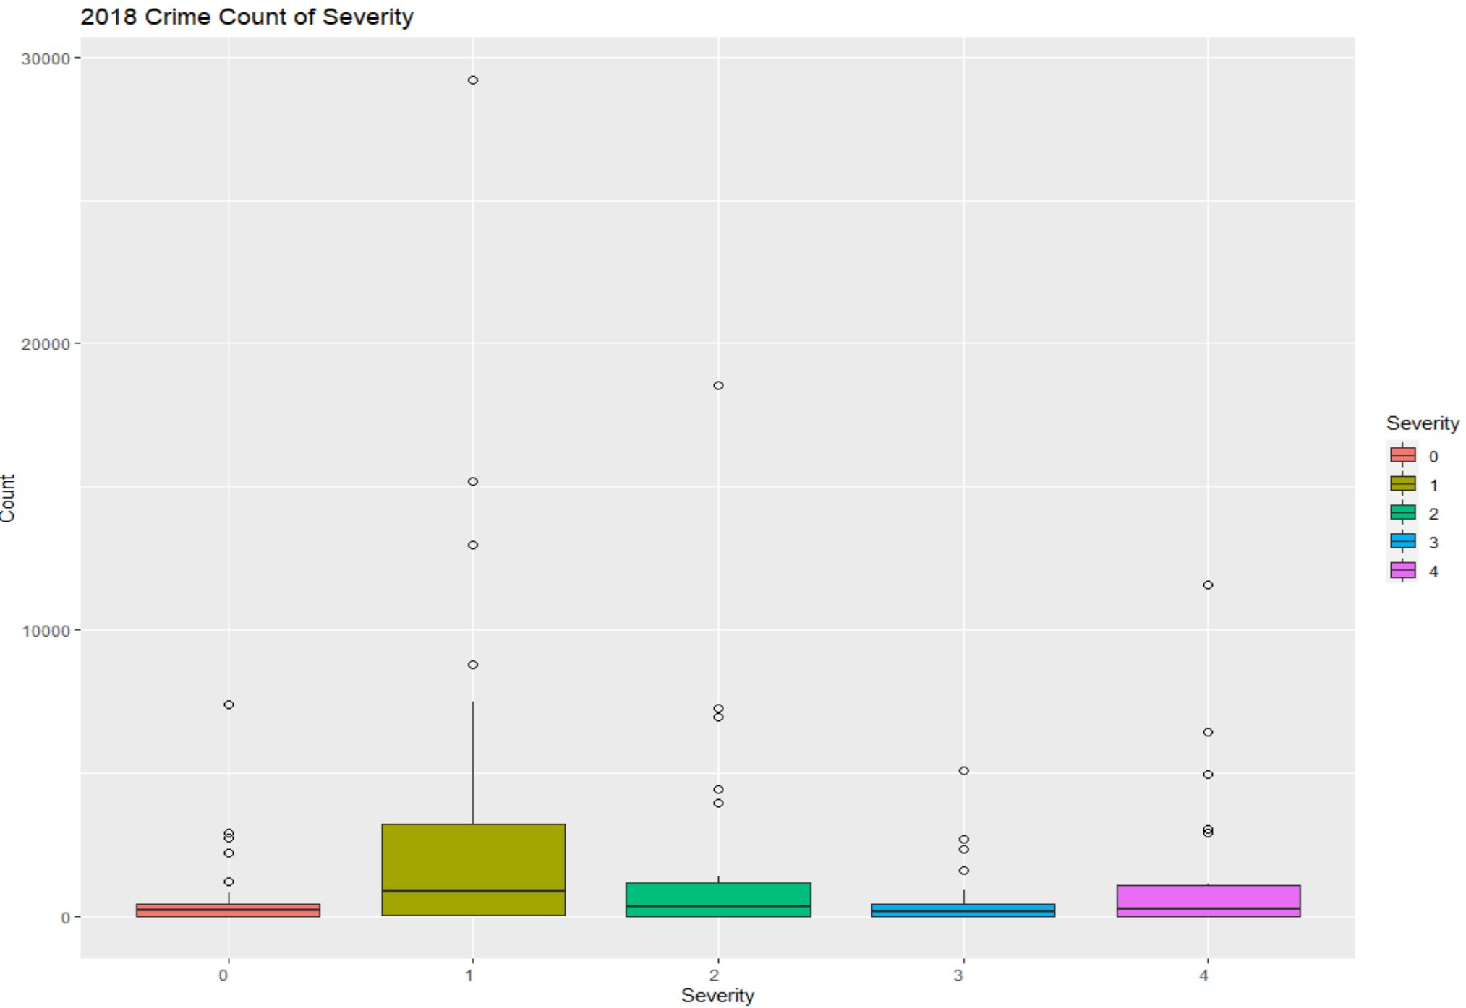
Data2: Police Dispatched Incidents
continued
Total amount of Crime by Severity – Boxplot (2018)
Max: 29210
Max: 18529
15190
12965
Max: 11573
Max: 7422
7300
Max: 5116
Q3: 3385.50
6977
6442
Median: 898
Q3: 1261
2699
2944
2360
4975
Q1: 55.50
Median: 387
2774
Q1: 24
Q3: 501
Q3: 1114
Q3: 549.00
Min: 14
Min: 6
Median: 176
Median: 293
Median: 216
Q1: 6
Q1: 23
Q1: 17.75
Min: 3
Min: 2
Min: 2

Slide 13
Data2: Police Dispatched Incidents
continued
Total amount of Crime by Severity – Boxplot (2019)
Max: 27293
14336
12604
Max: 17809
6884
Max: 12281
6571
Q3: 1293.75
6953
Max: 7049
5018
Median: 356
Max: 5008
2980
Q3: 3324
Q1: 33.50
2738
Median: 859
Min: 8
2808
Q3: 1185.50
Q3: 515.75
Q1: 53.50
2389
Median: 340
Median: 213
Min: 18
Q3: 458
Q1: 21
Q1: 12
Median: 149
Min: 3
Min: 2
Q1: 11.25
Min: 0

Slide 14
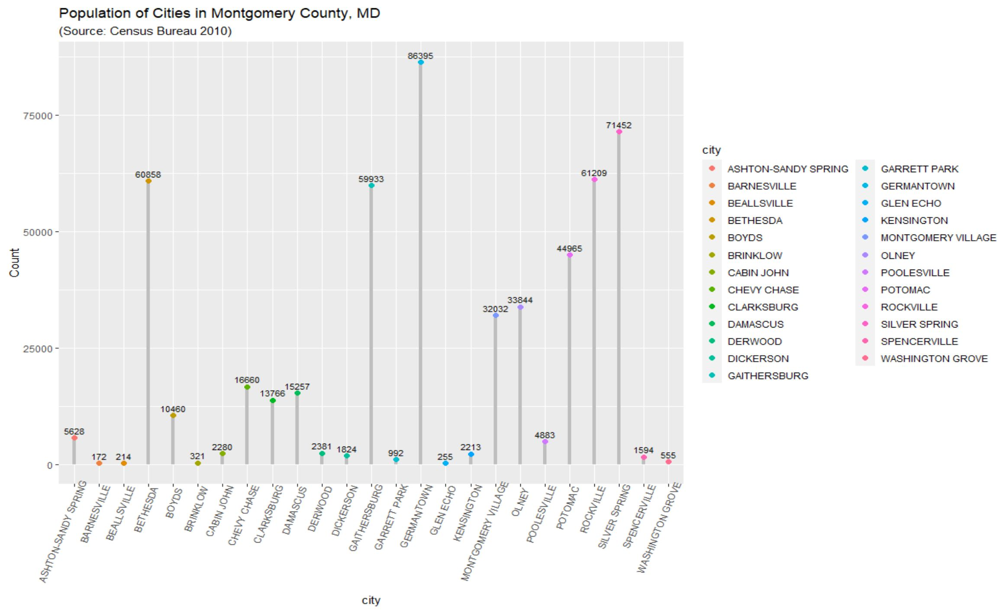
Data3: Population - Census Bureau 2010

Slide 15
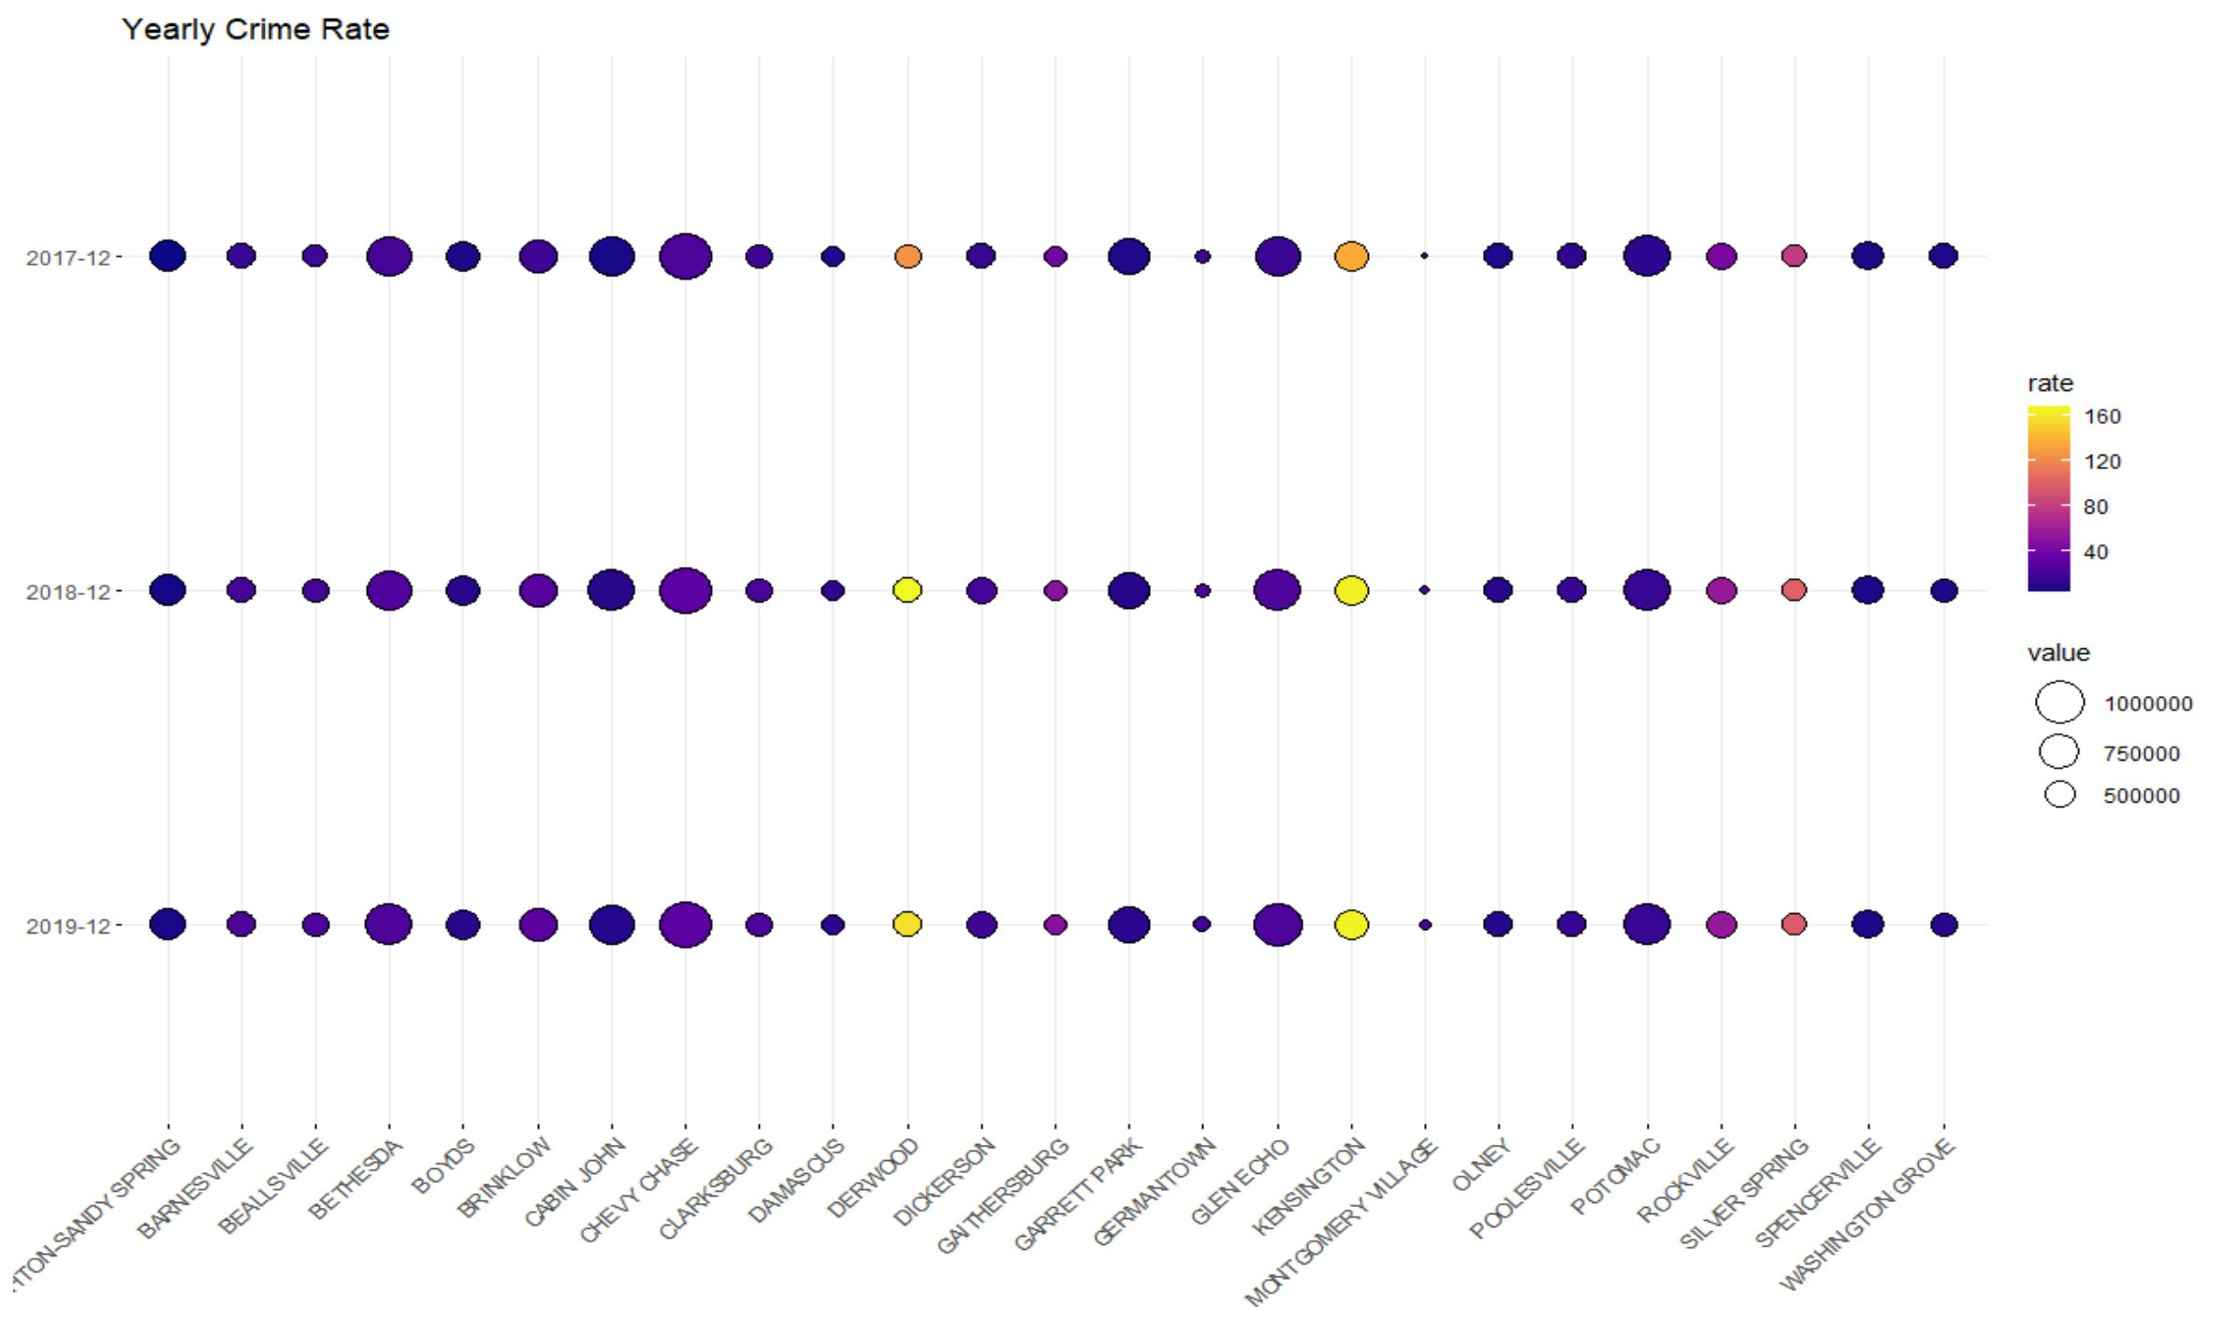
Details and Insights
2
3
4
Crime Frequency (Yearly)
0
1
2017
17,620
69,158
44,132
10,443
28,196
2018
20,251
92,240
49,201
15,773
35,514
2019
19,420
86,983
46,750
15,572
36,778
Crime Frequency by city (Yearly)
Crime Rate = (Total Crimes / Population) X 100

Slide 16
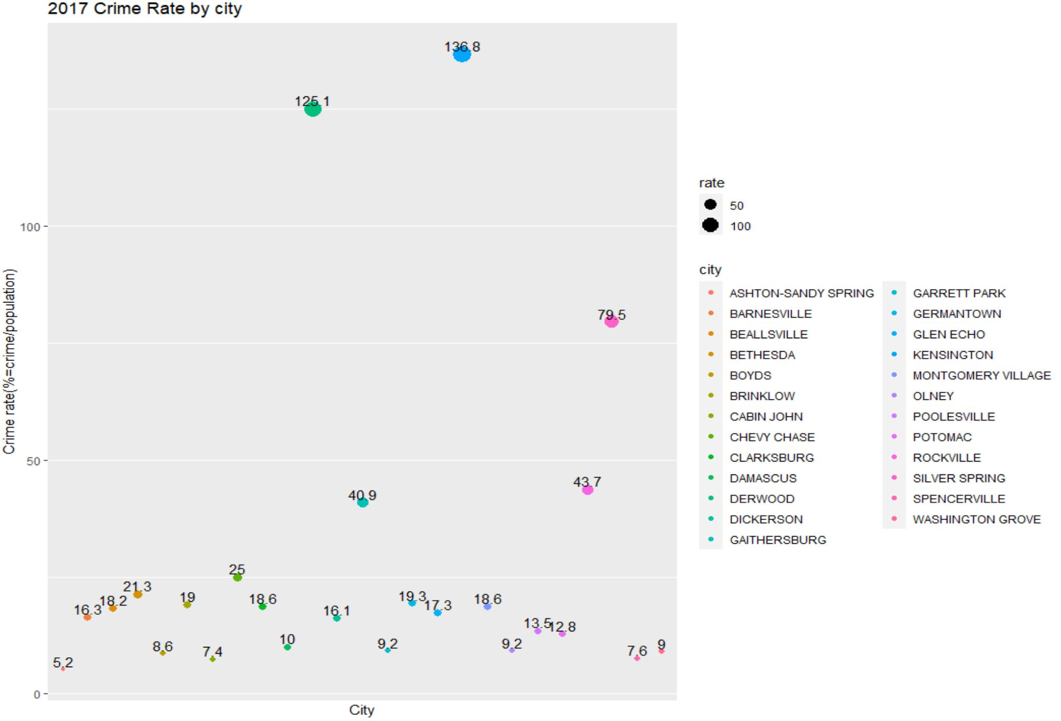
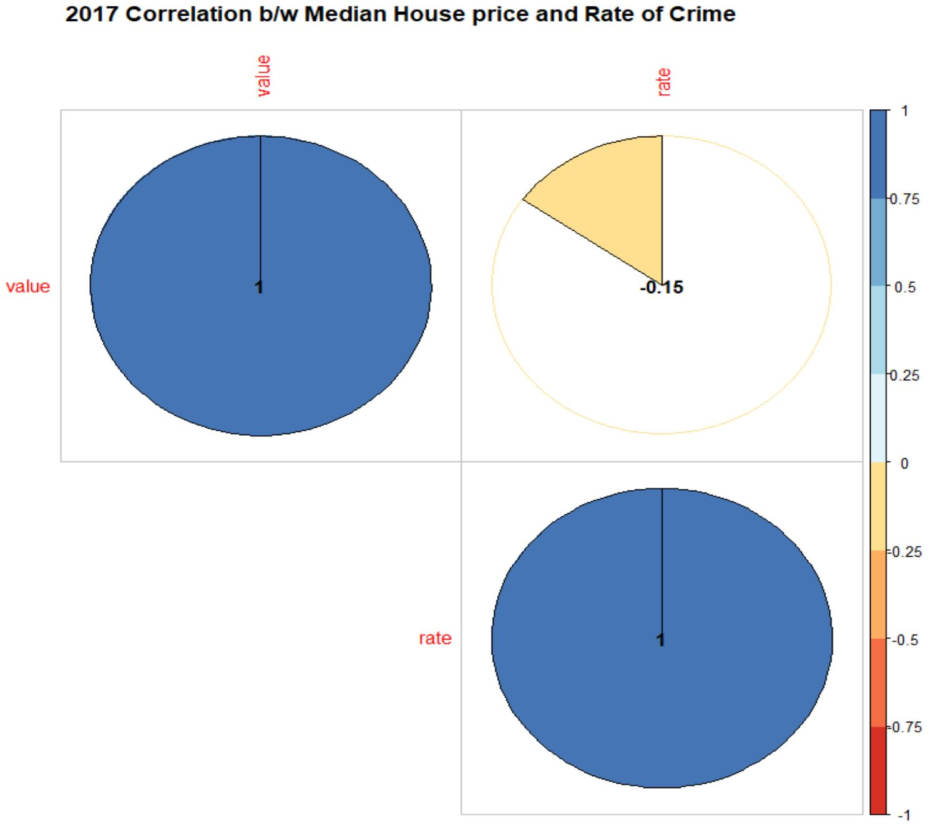
Details and Insights
continued
Crime Frequency by City (Yearly)
Silver Spring
Beallsville
Montgomery Village
Chevy Chase
Gaithersburg
Germantown
Damascus
Potomac
Bethesda
Glen Echo
Cabin John

Slide 17
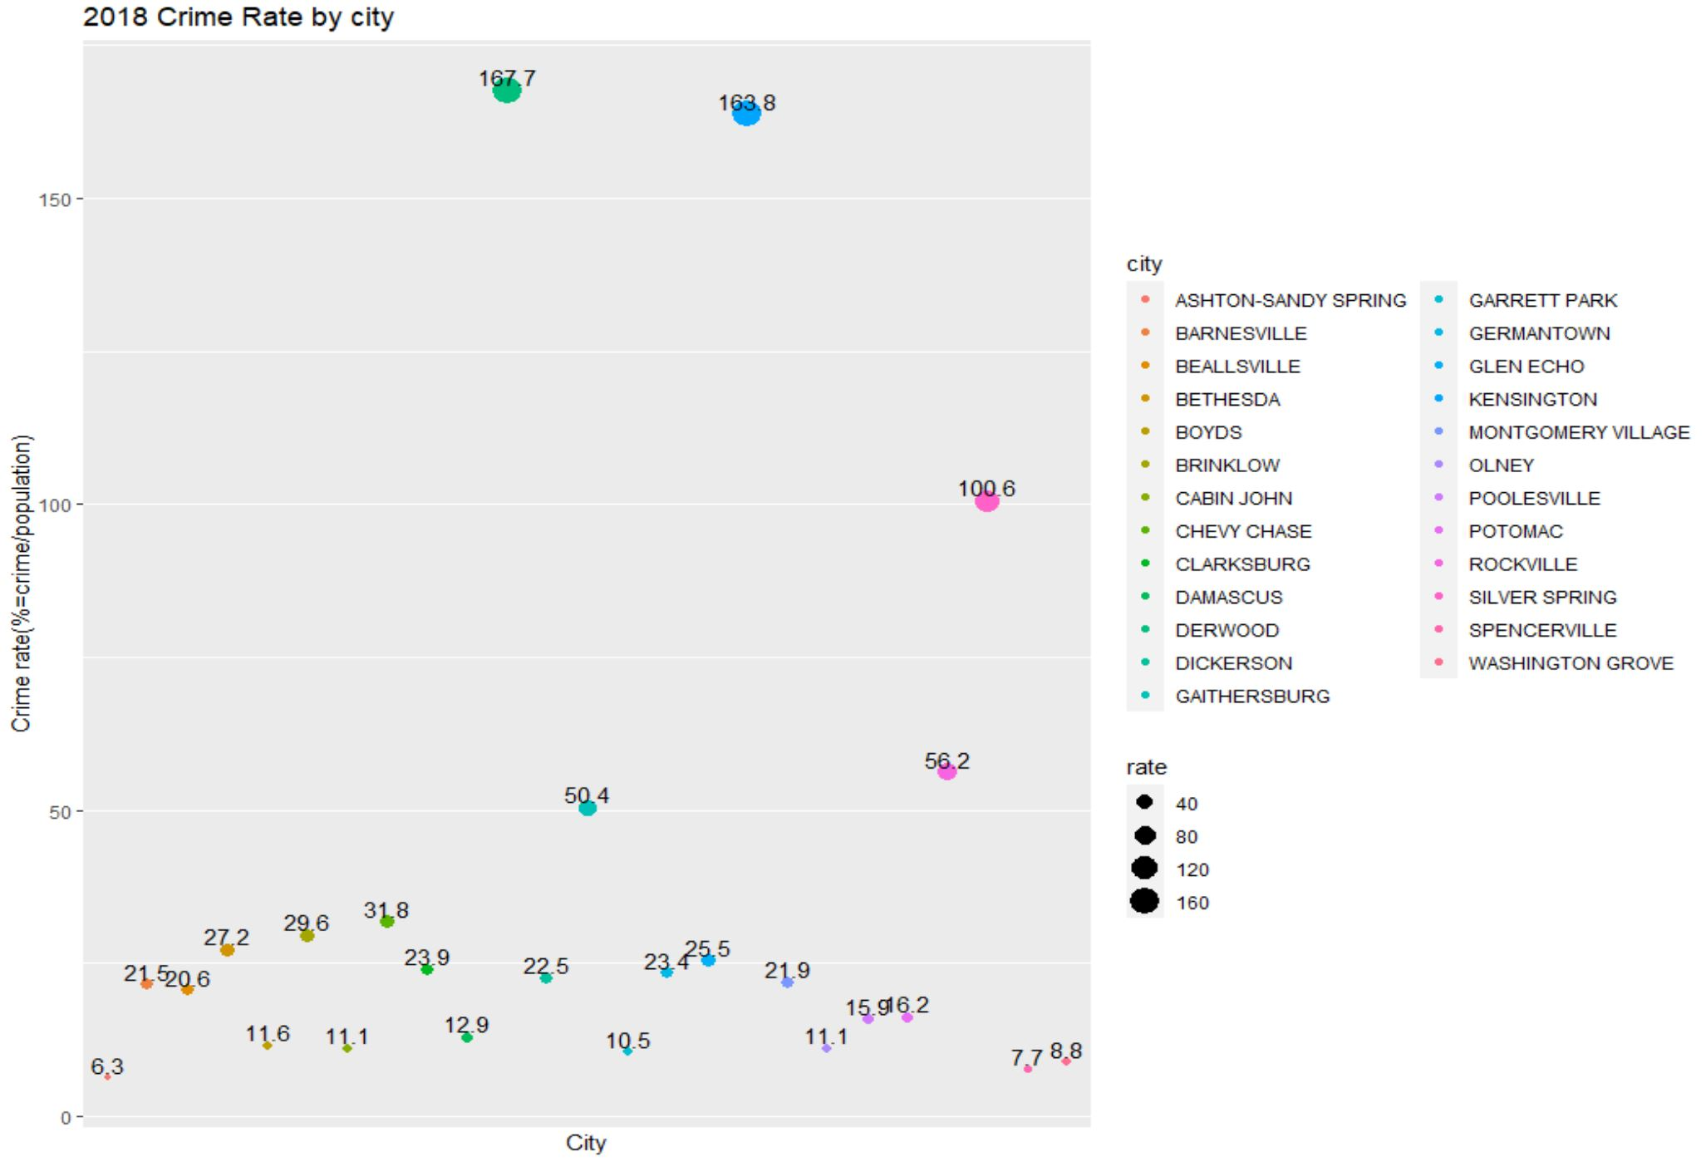
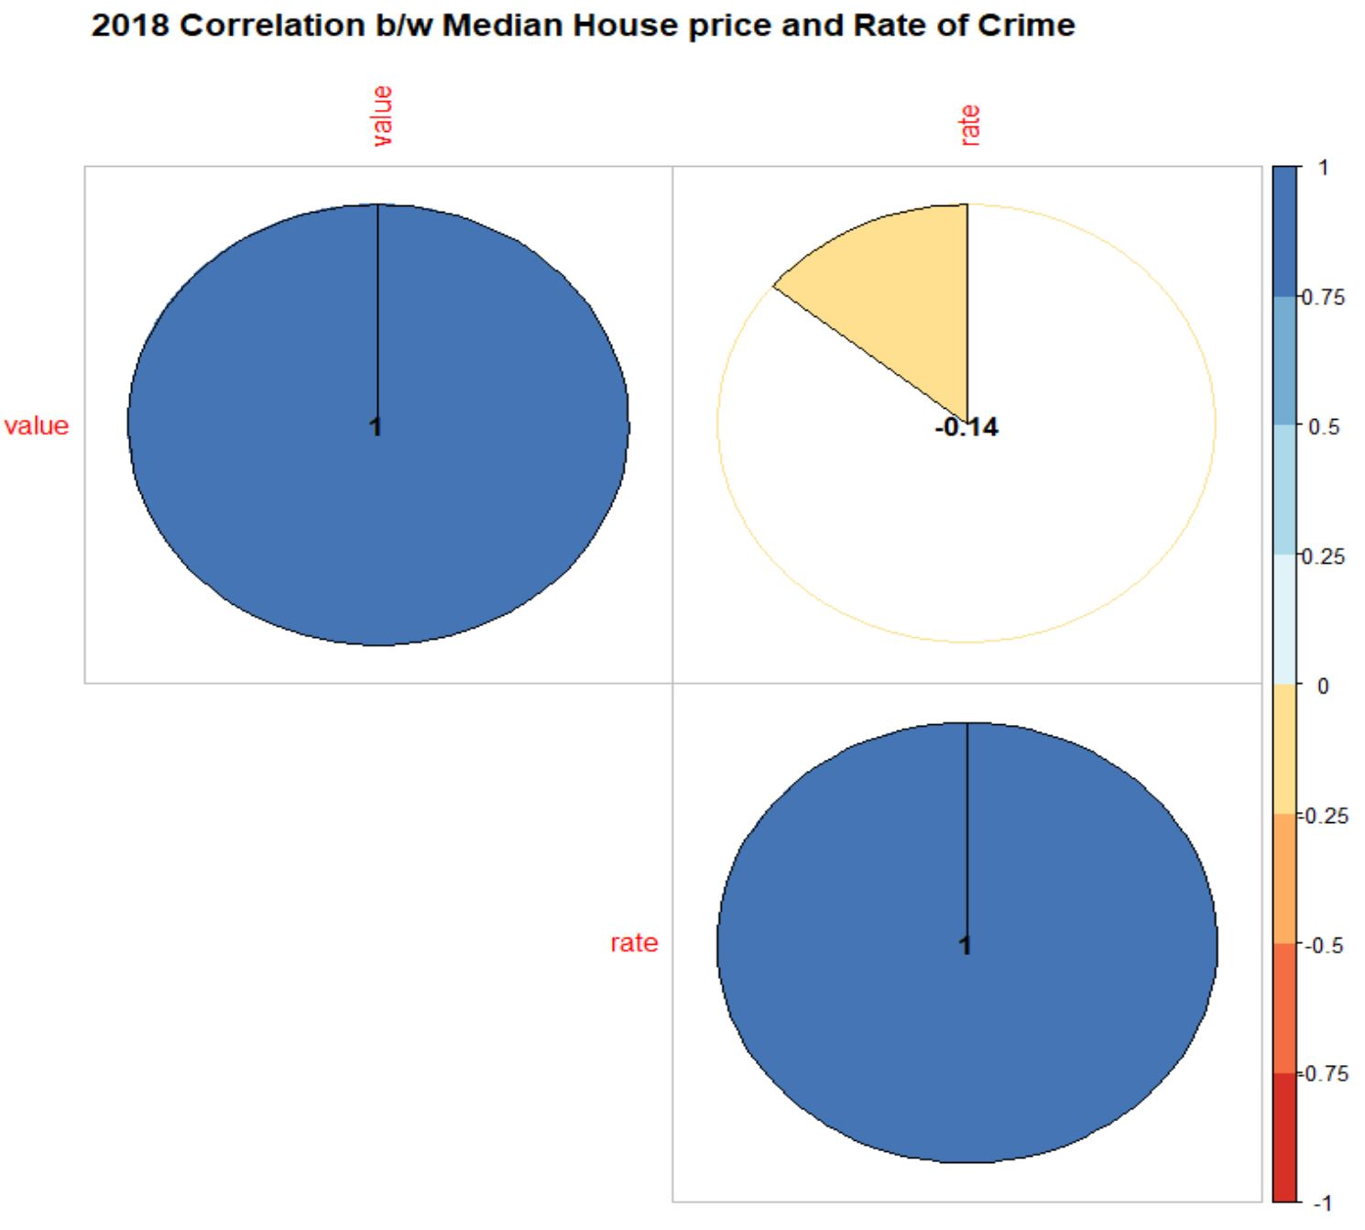
Details and Insights
continued
Crime Frequency by City (Yearly)
Montgomery Village
Chevy Chase: 31.8
Beallsville: 20.6
Potomac: 16.2
Silver Spring: 100.60
Glen Echo: 25.5
Damascus:12.9
Bethesda: 27.2
Gaithersburg: 50.40
Cabin John: 11.1
Germantown: 23.4

Slide 18
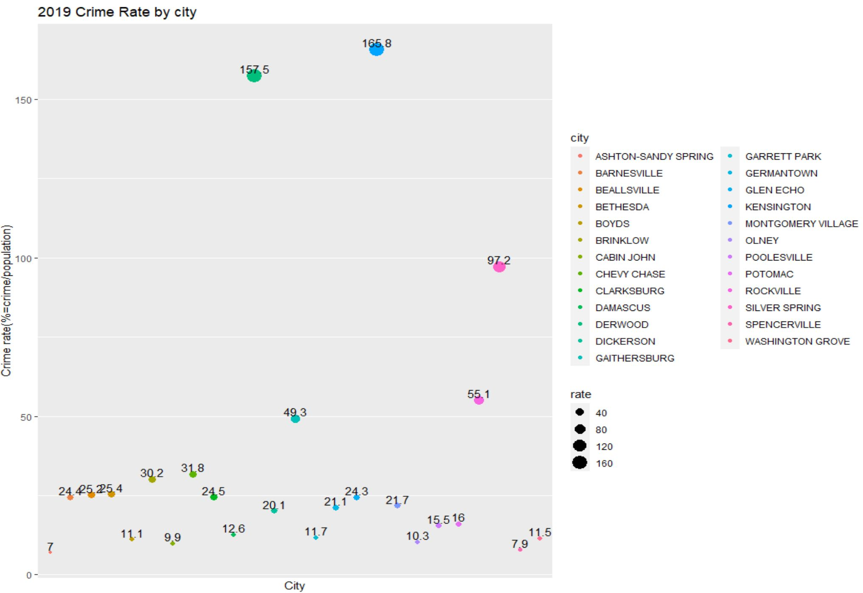

Details and Insights
continued
Crime Frequency by City (Yearly)
Montgomery Village
Chevy Chase: 31.80
Beallsville: 25.2
Potomac: 16.00
Silver Spring: 97.20
Glen Echo: 24.30
Damascus:12.60
Bethesda: 25.40
Gaithersburg: 49.30
Cabin John: 9.9
Germantown: 2.10

Slide 19
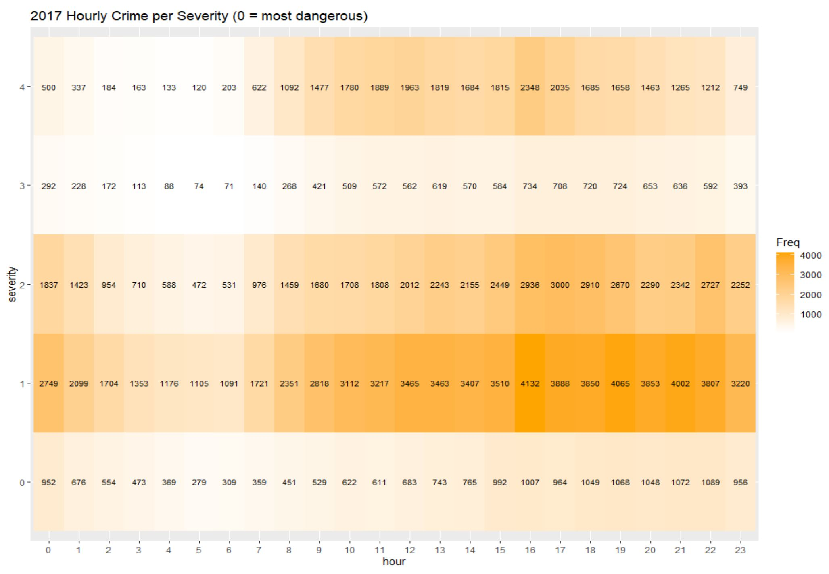
Details and Insights
continued
Total Crimes (from 2017 to 2019)
Crime Frequency by Severity (Hourly) - Heatmap
0
60,932
1
264,985
2
148,890
3
44,494
4
107,789
Total Crimes (2017)
0
17,620
1
1
69,158
2
44,132
3
10,443
4
28,196

Slide 20
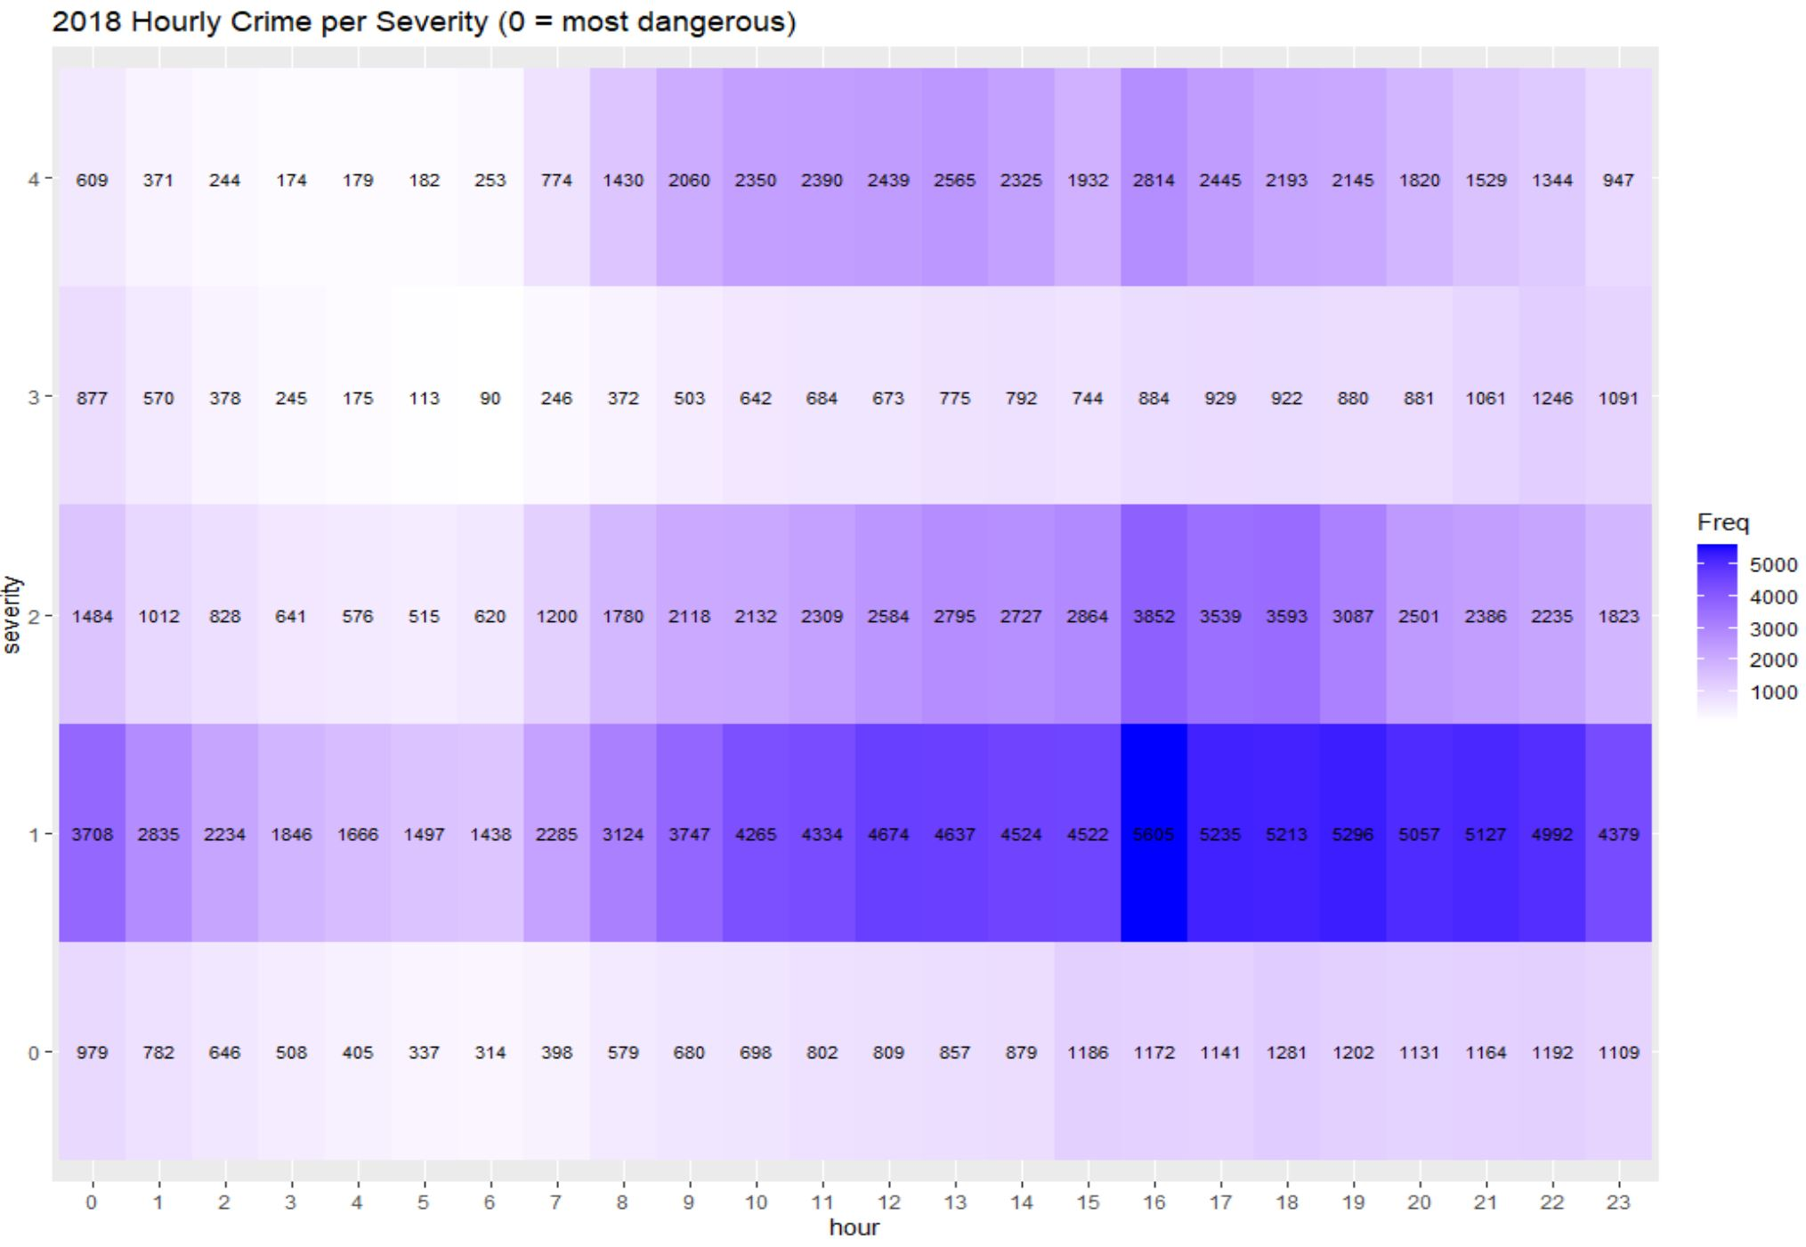
Details and Insights
continued
Total Crimes (2018)
Crime Frequency by Severity (Hourly) - Heatmap
0
20,251
1
92,240
2
49,201
3
15,773
4
35,514
1

Slide 21
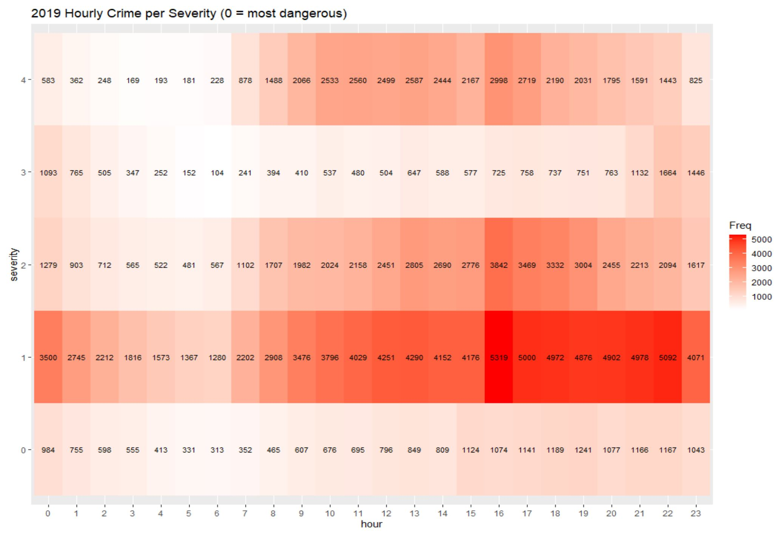
Details and Insights
continued
Total Crimes (2019)
Crime Frequency by Severity (Hourly) - Heatmap
0
19,420
1
86,983
2
46,750
3
15,572
4
36,778
1

Slide 22
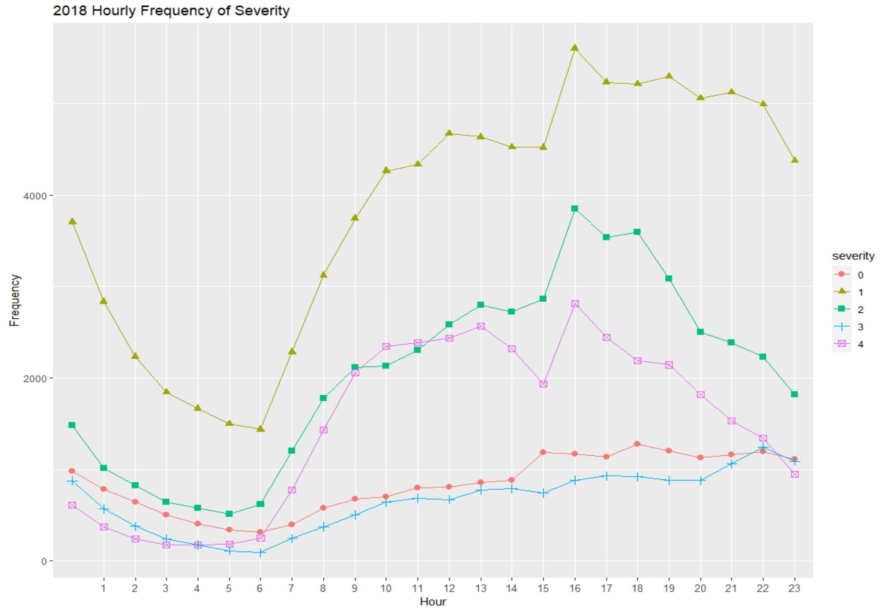
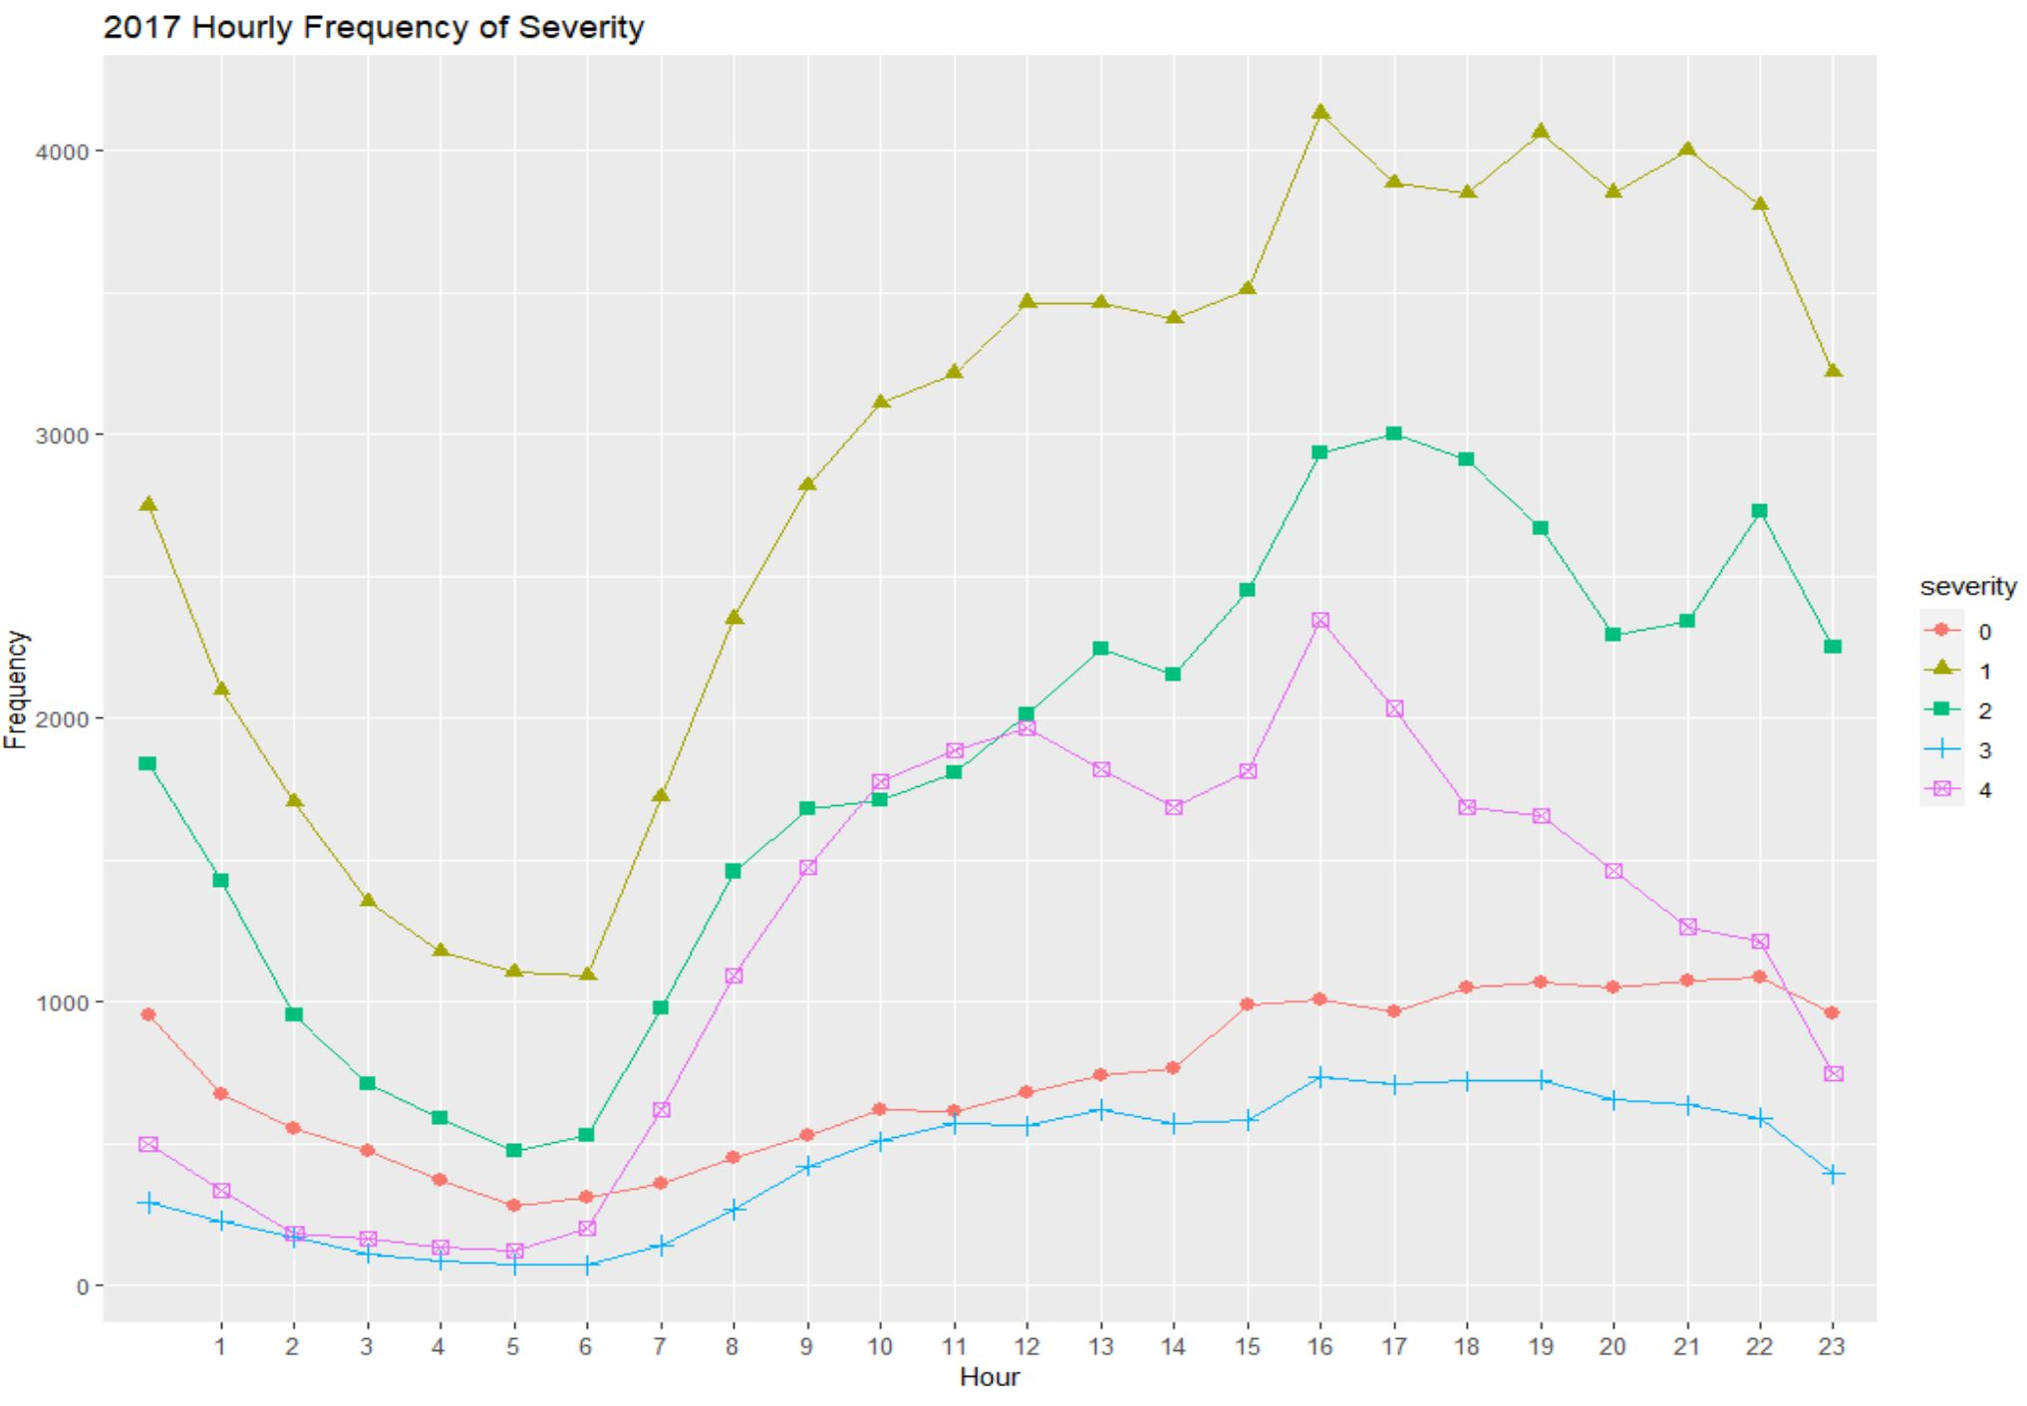
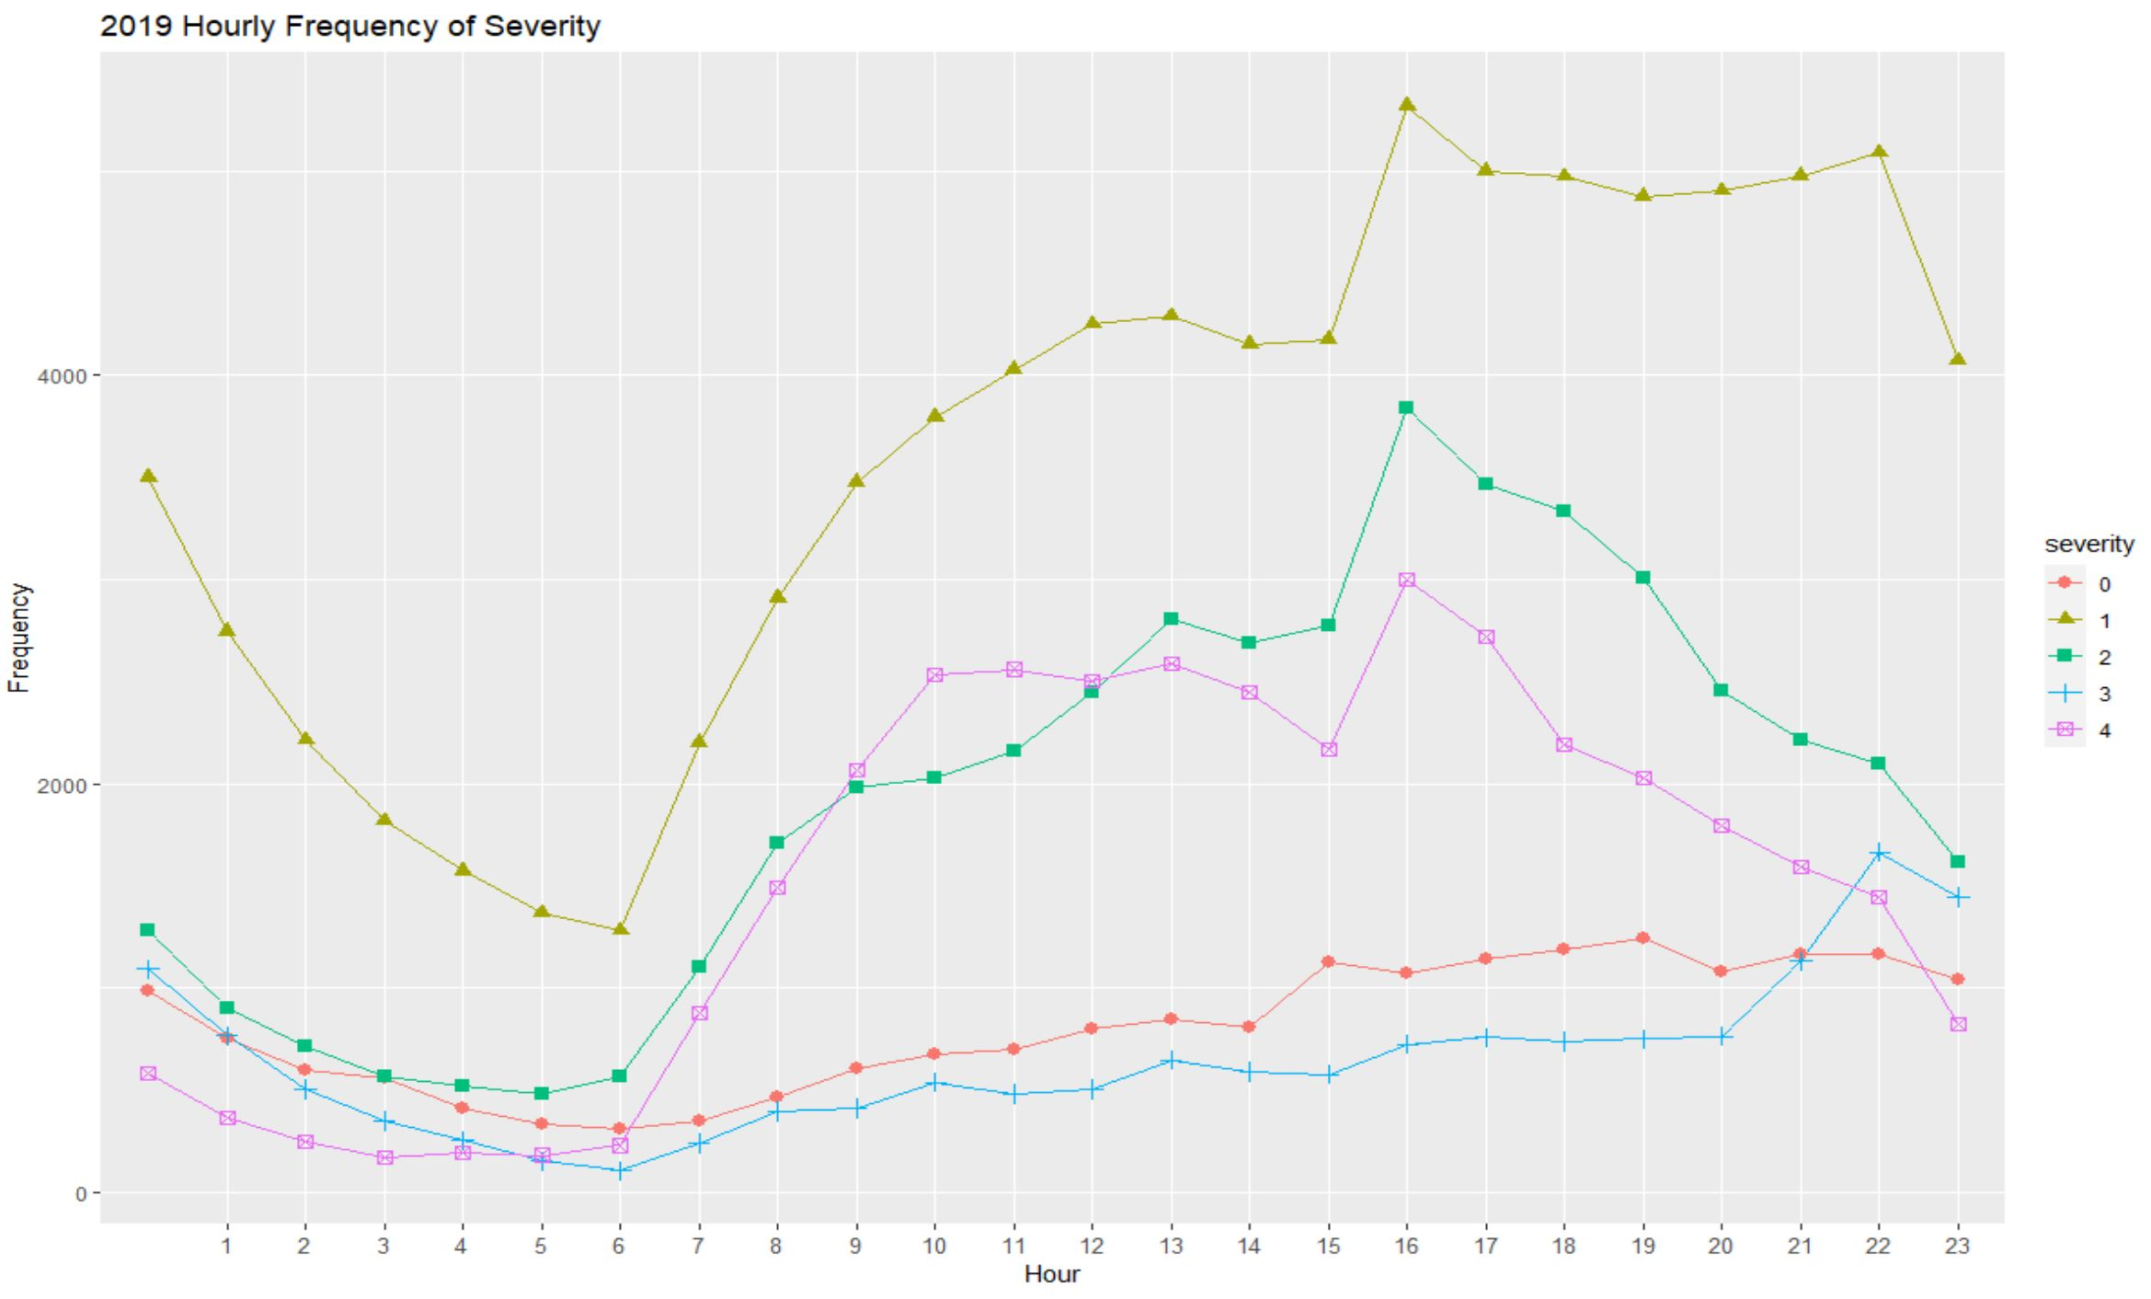
Details and Insights
continued

Slide 23
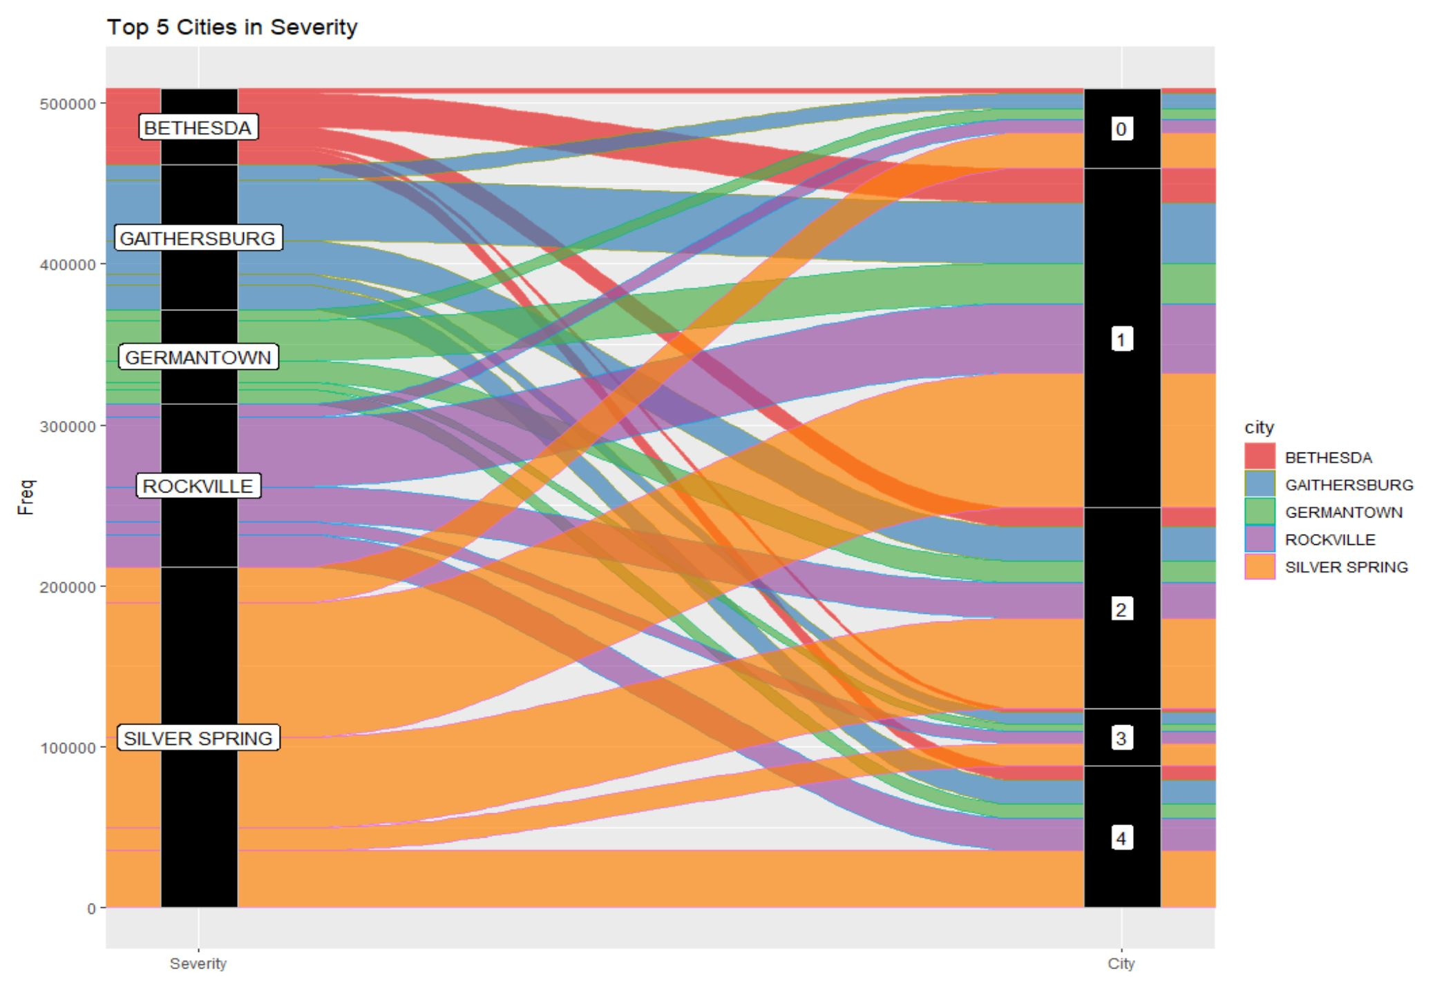
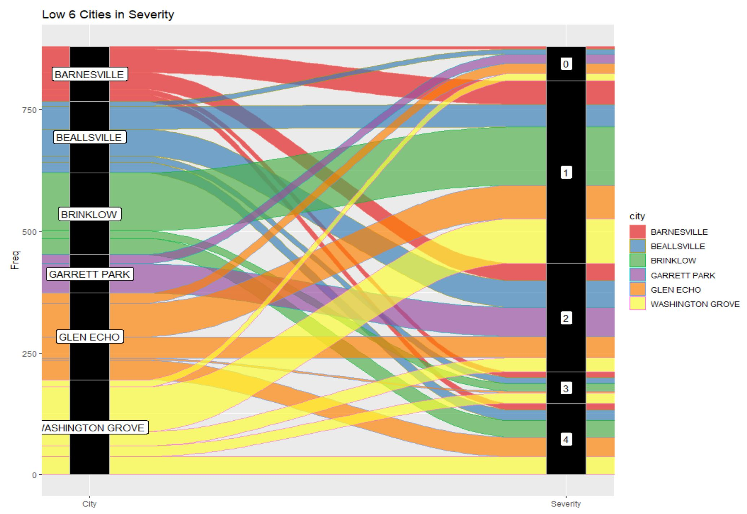
Details and Insights
continued
Top 5 (crime amount) Cities for 3 years - Alluvial plot
Low 6 (crime amount) Cities for 3 years- Alluvial plot

Slide 24
Results
The first hypothesis was not proven due to low correlation between median house price and crime rate.
The second hypothesis was shown to be accurate as seen in previous graphs.
Useful data to increase awareness of when and where most crimes occur

Slide 25
Acknowledgements
Thanks to Prof. John Hamman, Prof. Rachel Saidi, Prof. Abdirisak Mohamed, Dennis Linders, Montgomery County Government, and Victoria Lewis, dataMontgomery for the support and direction!!!

Slide 26
- Hye Young Park
Thank you!!!

